Slide 1
Module B
Unit B2
Vocabulary
Language Functions
Speaking Activities
UTN FRVM Lic. Evangelina Cecchel - Lic. Bibiana Fernandez

Slide 2
Vocabulary: news
UTN FRVM Lic. Evangelina Cecchel - Lic. Bibiana Fernandez

Slide 3
Analyze analysis
Announce announcement
Appoint appointment
Combine combination
Criticize criticism
Develop development
Endorse endorsement
Press pressure
Propose proposal
React reaction
Recommend recommendation
UTN FRVM Lic. Evangelina Cecchel - Lic. Bibiana Fernandez

Slide 4
What are the corresponding nouns?
Arrive
Enjoy
Create
Treat
Rent
Register
…ment
…tion
…al
…ism
Can you think of other examples?
UTN FRVM Lic. Evangelina Cecchel - Lic. Bibiana Fernandez

Slide 5
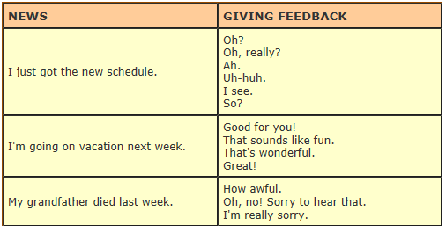
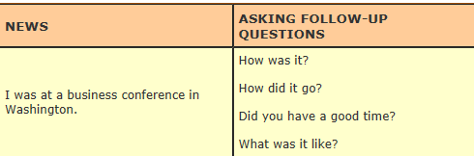
UTN FRVM Lic. Evangelina Cecchel - Lic. Bibiana Fernandez

Slide 6
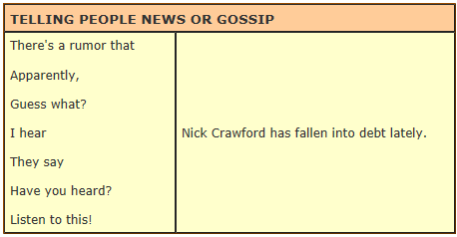
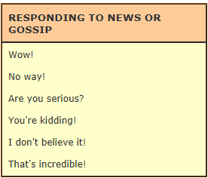
UTN FRVM Lic. Evangelina Cecchel - Lic. Bibiana Fernandez

Slide 7
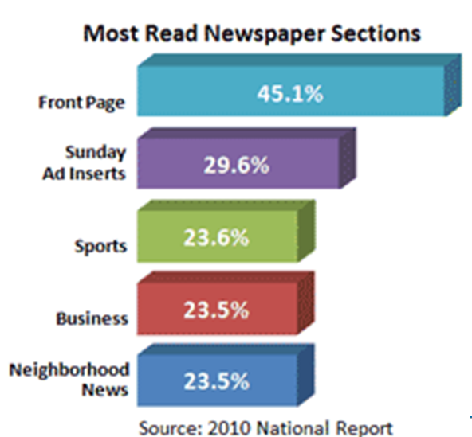
What are the latest news?
UTN FRVM Lic. Evangelina Cecchel - Lic. Bibiana Fernandez

Slide 8
Activity: Go to the front page of
www.frvm.utn.edu.ar
and report the latest news
UTN FRVM Lic. Evangelina Cecchel - Lic. Bibiana Fernandez

Slide 9
Language function:
Talking about past habits
UTN FRVM Lic. Evangelina Cecchel - Lic. Bibiana Fernandez

Slide 10
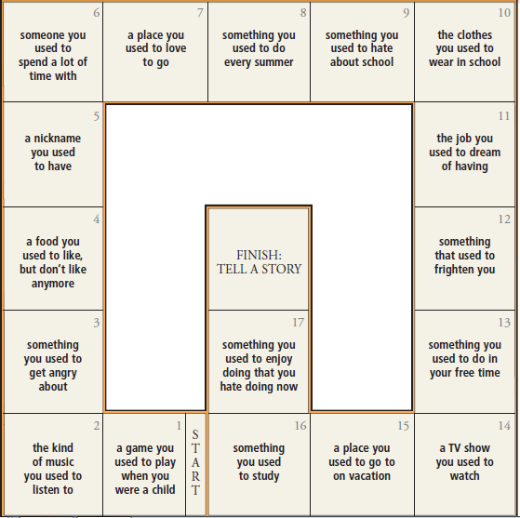
Activity: Talk about past habits.
E.g.: I used to play tennis
Did you use to read comics?
UTN FRVM Lic. Evangelina Cecchel - Lic. Bibiana Fernandez

